Slide 1
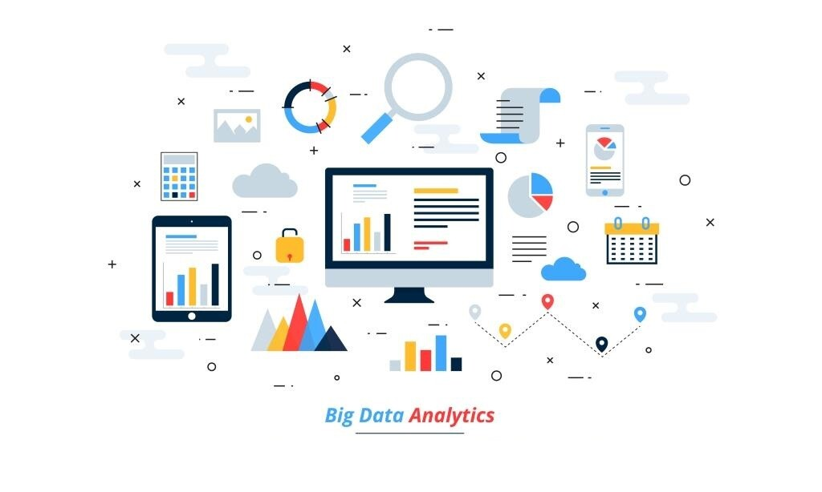

ANALYZING TRENDS FOR BETTER CUSTOMER EXPERIENCE

Slide 2






Problem Statement
Aim Of the Project
Steps to be Followed
Project Summary
Conclusion

Slide 3
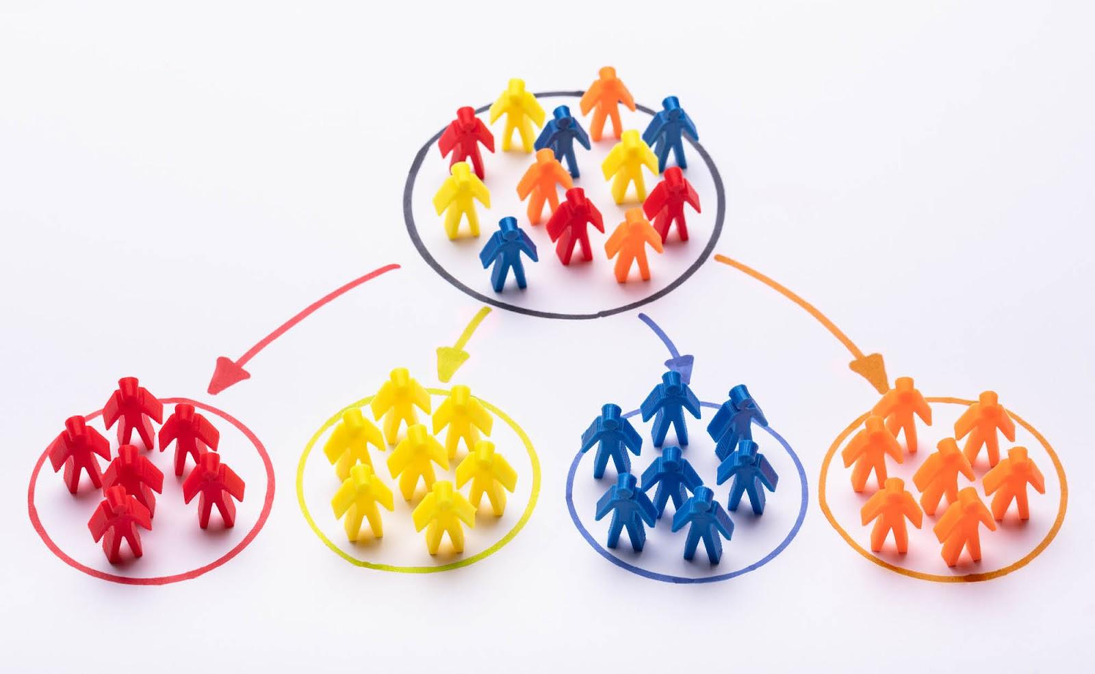
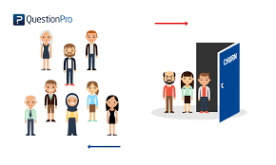
Problem Statement
Customer Segmentation Discovering what each segment of customer finds most valuable to more accurately tailor marketing materials toward that segment (divided on the basis of age, gender, interests, etc.) Customer Churn Recovered long-term customers can be worth much more to a company than newly recruited clients who have a higher churn. These in turn cause a huge loss to them.

Slide 4


Aim Of the Project
To divide a customer base into groups of individuals that are similar in specific ways relevant to marketing, such as age, gender, interests and spending habits.
Given a customer profile , predicting how likely they are to churn.To understand the precise customer behaviors and attributes which signal the risk and timing of customer churn.

Slide 5
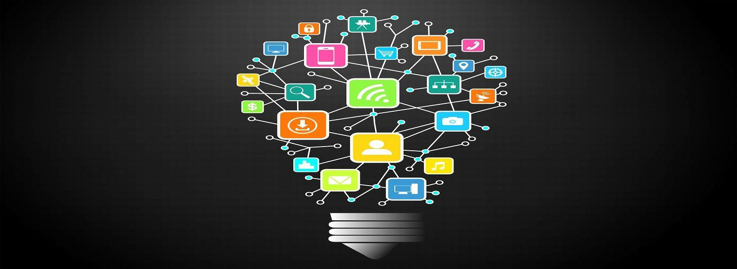
Technologies Used
Kmeans
Machine Learning Algorithms
Classification
Clustering

Slide 6
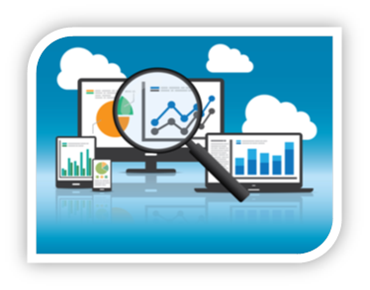

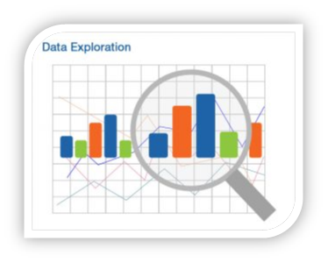
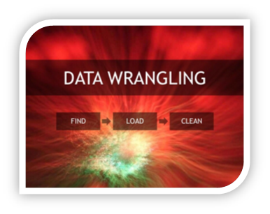
Steps
04
Data Visualization
03
Data Modeling
02
Data Exploration
Data Wrangling
01

Slide 7
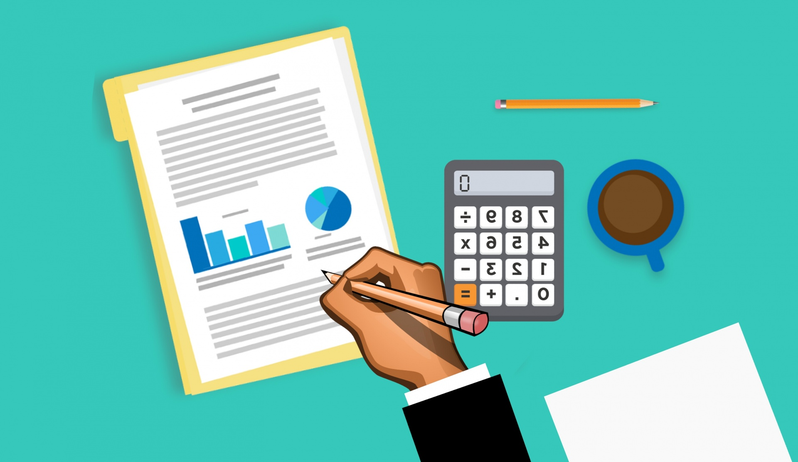
Data Exploration
Gathering of data and dataset

Slide 8
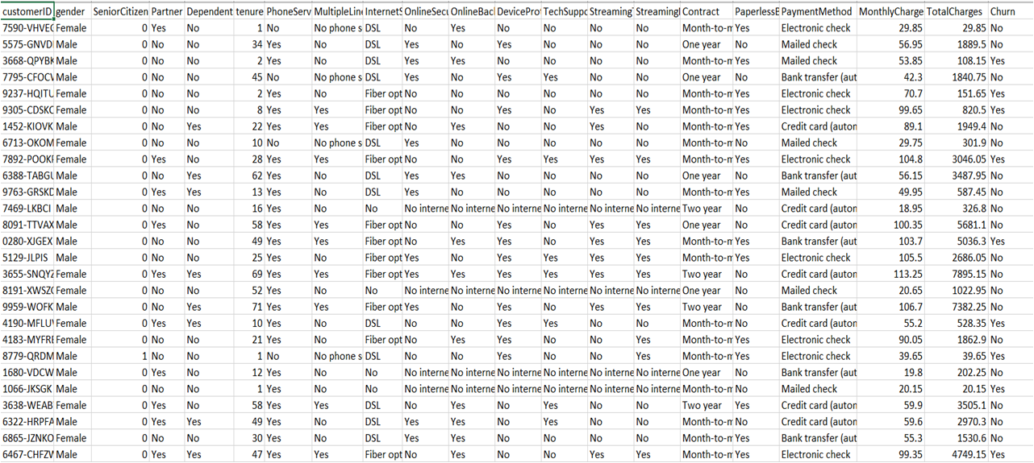
Dataset
Link to the Dataset :- https://www.kaggle.com/blastchar/telco-customer-churn

Slide 9

Data Wrangling
Cleaning and unifying messy and complex data sets for easy access and analysis

Slide 10
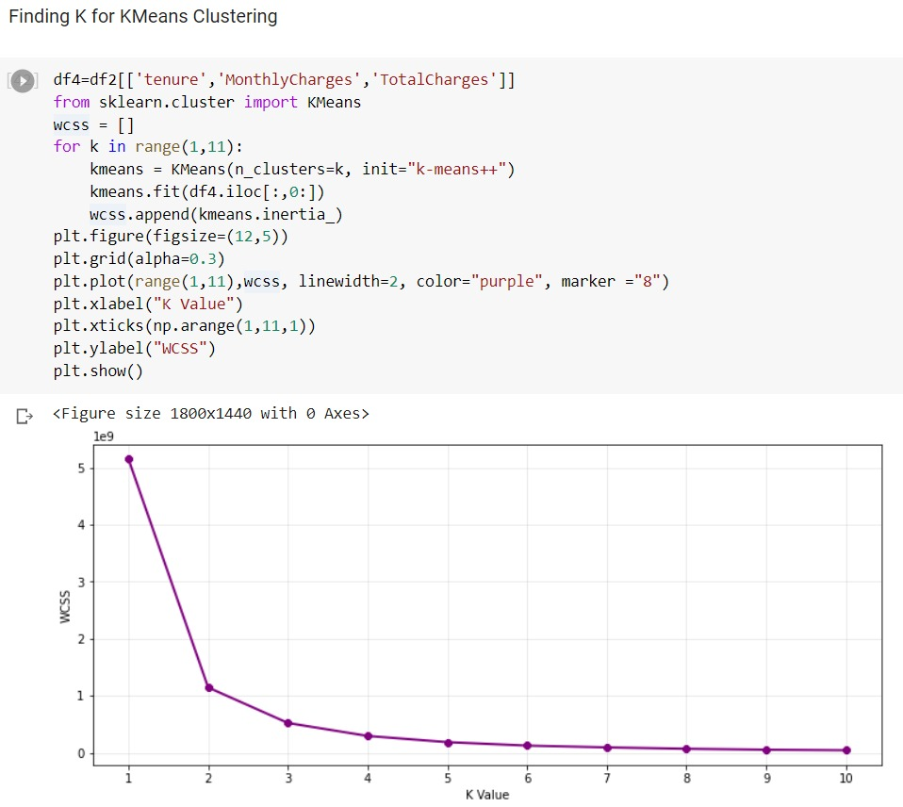
Data Analysis
Customer Segmentation
Plotted different plots and graphs namely count plot, histograms, relation plots, category plots, violin plots etc.​
Out of 21 features, 5 features played an important role in varied Customer Behavior namely Tenure of the customer, Monthly Charges, the Total Charges, The Payment Method and the Contract. ​
Kmeans came out to be 3, thereby giving us 3 clusters having same behavioral aspects within and different behavioral aspects from each other.​

Slide 11
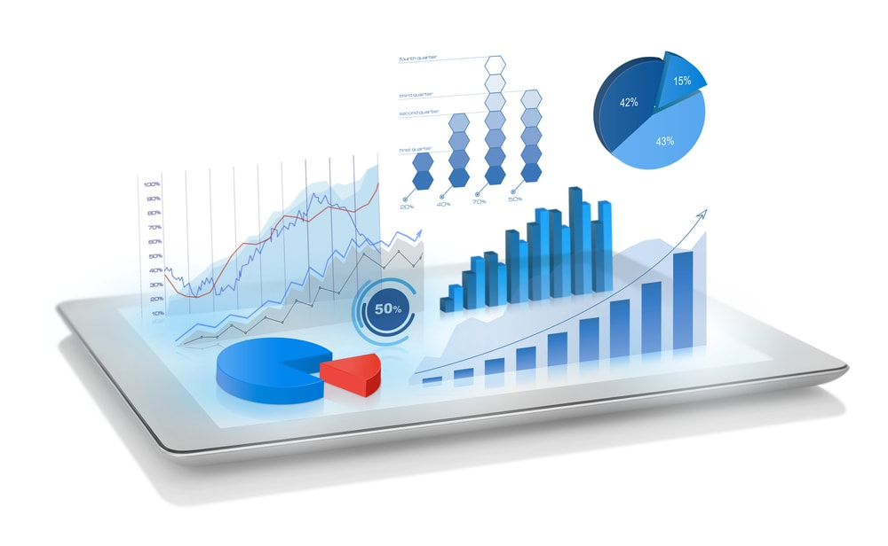
Data Visualization
Customer Segmentation

Slide 12
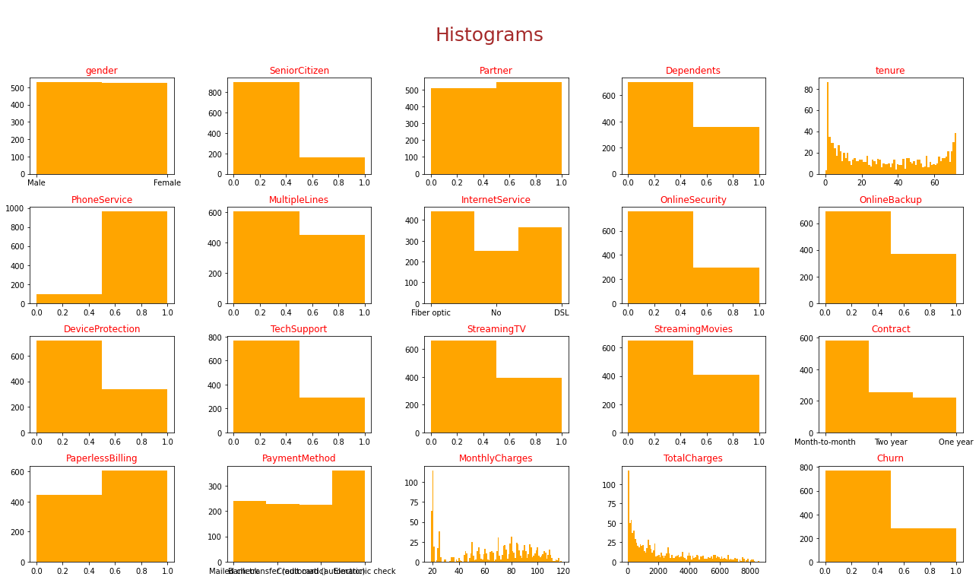
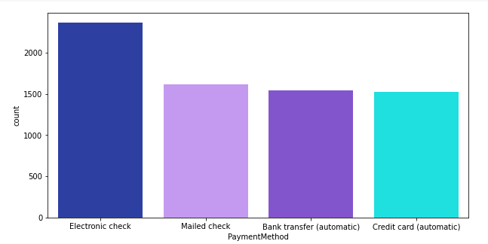
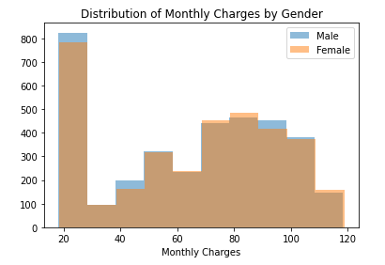
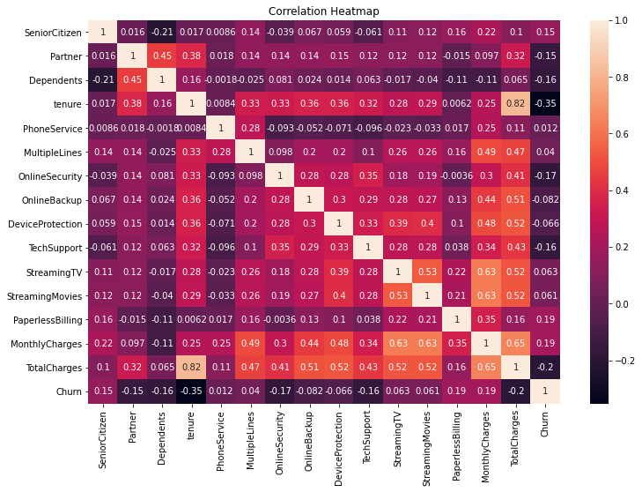
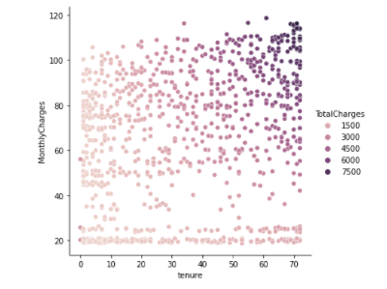
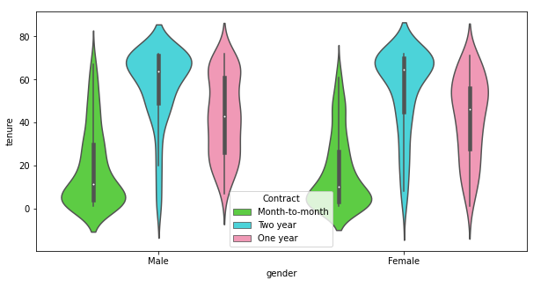

Slide 13

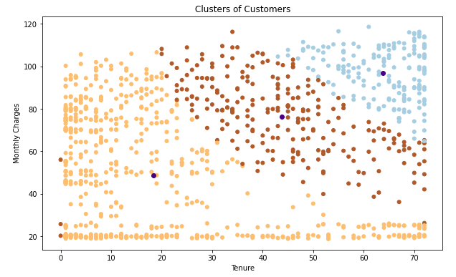
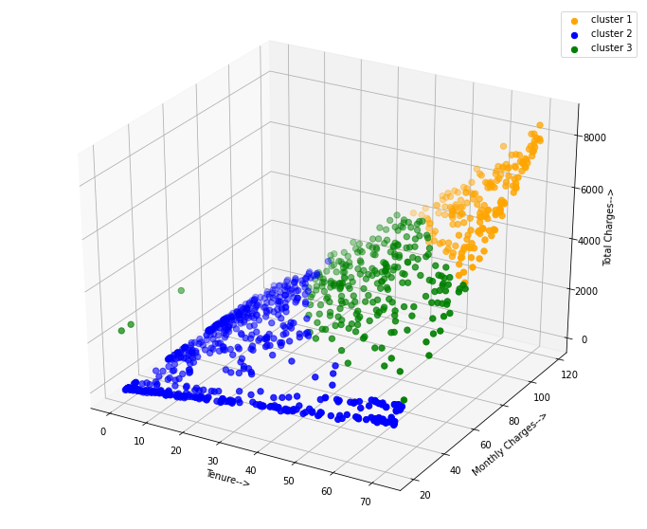
These graphs depicts that customers separated into clusters and therefore, customer segmentation is completed

Slide 14

Data Analysis
High Churn seen in case of Month to month contracts, No online security, No Tech support, First year of subscription and Fiber Optics Internet.
Customer Churn
Low Churn is seen in case of long term contracts, subscriptions without internet service and the customers engaged for 5+ years.
Factors like Gender, Availability of Phone Service and of multiple lines have almost NO impact on Churn.
With Random Forest Classifier, also we are able to get quite good results, in fact better than Decision Tree.

Slide 15
Data Visualization
Customer Churn

Slide 16
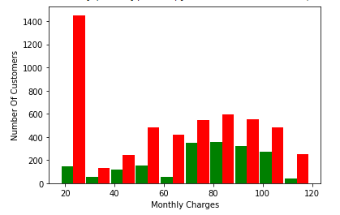
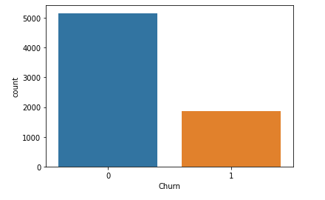
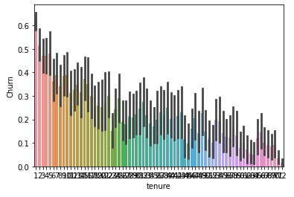
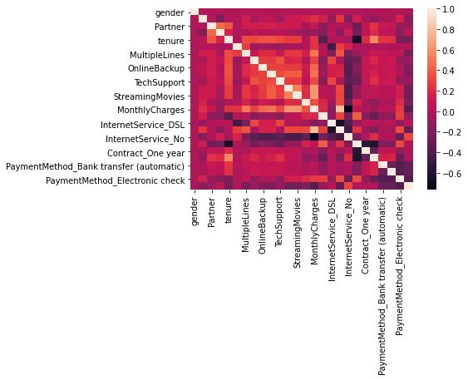
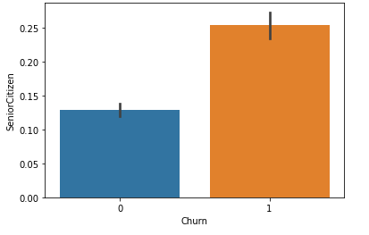
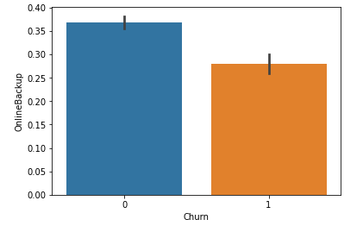
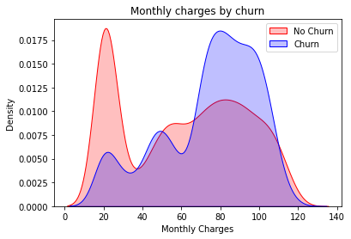
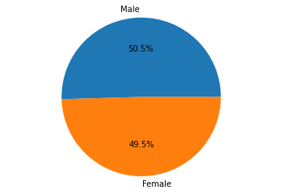
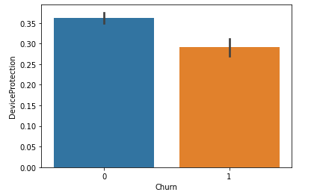

Slide 17

Our project includes Customer Segmentation and their corresponding Attrition Rate.
Project Summary
Customer Segmentation analysis allows marketers to identify discrete groups of customers with a high degree of accuracy based on demographic, behavioral and other indicators.
The marketer’s goal is usually to maximize the value (revenue and/or profit) from each customer, it is critical to know in advance how any particular marketing action will influence the customer.

Slide 18

Customer Churn gives your company the hard truth about its customer retention.
It costs more to acquire new customers than it does to retain existing customers, as returning customers will likely spend more on the company's products.
As a result, the company can spend less on the operating costs of having to acquire new customers.

Slide 19

Conclusion
We have concluded that there are majorly 3 groups of customers with similar behavior.
The company can orient its product and service in the direction of these groups made
Enable company to reach out to more number of customers and easily promote their products and services in different strata's of the society.
Electronic check medium are the highest churners
Contract Type - Monthly customers are more likely to churn because of no contract terms, as they are free to go customers.
No Online security, No Tech Support category are high churners, Non senior Citizens are high churners
If the company is able improve upon these, it will experience lesser churn rate thereby increasing more profits than losses.

Slide 20
Future Scope
This model can be forecasted across various businesses
Combining customer demographic and behavioural data with customer feedback data, helps you capture what various persons want and need from your company.
Business will possess stronger customer focus and market clarity, allowing it to scale in a far more predictable and efficient manner.
Churn by line of business
Churn by product group
Model can be built to support Campaign responses

Slide 21


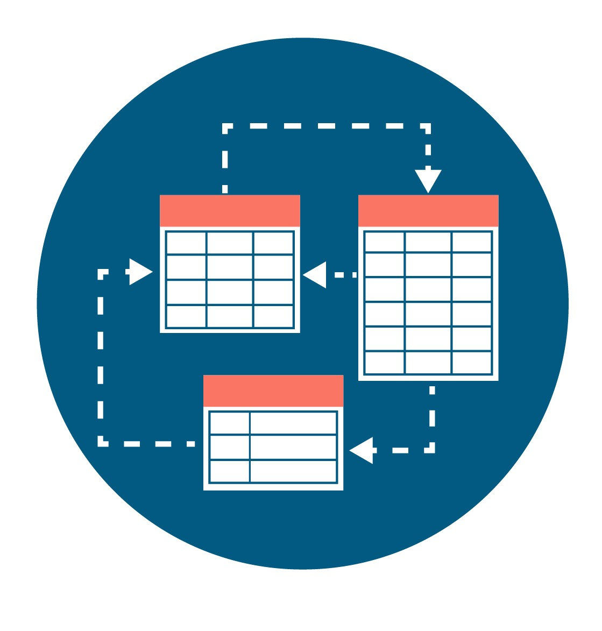
Thank You
Notes:
You can use this slide as your opening or closing slide. Should you choose to use it as a closing, make sure you review the main points of your presentation. One creative way to do that is by adding animations to the various graphics on a slide. This slide has 4 different graphics, and, when you view the slideshow, you will see that you can click to reveal the next graphic. Similarly, as you review the main topics in your presentation, you may want each point to show up when you are addressing that topic.
Add animation to images and graphics:
Select your image or graphic.
Click on the Animations tab.
Choose from the options. The animation for this slide is “Split”. The drop-down menu in the Animation section gives even more animations you can use.
If you have multiple graphics or images, you will see a number appear next to it that notes the order of the animations.
Note: You will want to choose the animations carefully. You do not want to make your audience dizzy from your presentation.

